Slide 1


Slide 2


Project By:
ANUDEEP BATHINA(18BEC006)
JEEVAN R H(18BEC017)
KIRAN D(18BEC022)
NIKHIL S A(18BEC033)
NITHIN R(18BEC034)
Submitted to:
Dr. Jagadeesha R B

Slide 3
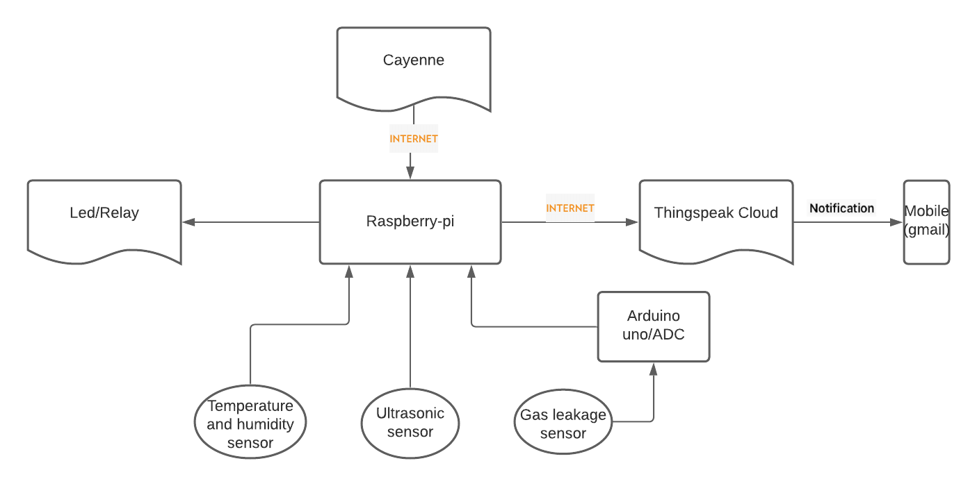
Block Diagram:

Slide 4
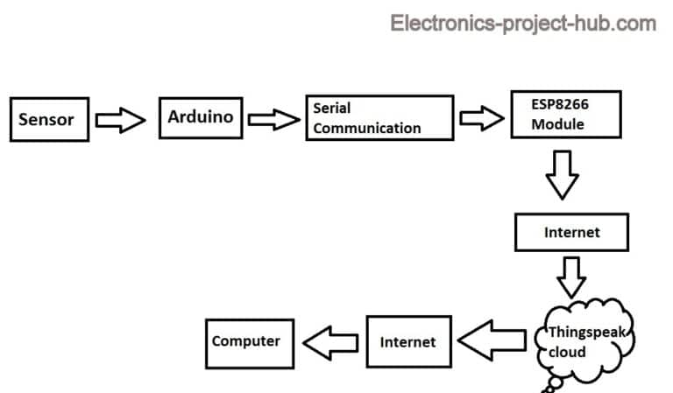
Block Diagram for Smart dustbin:

Slide 5
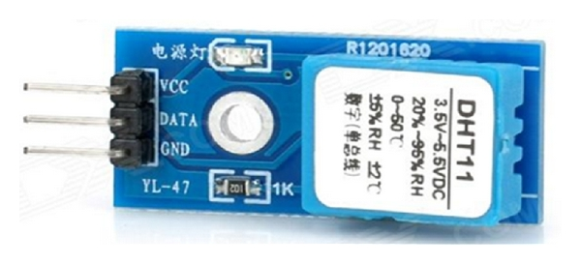
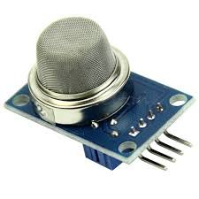
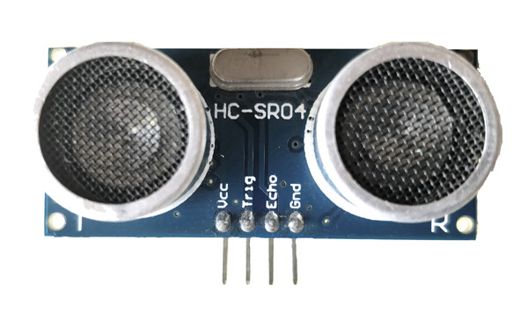
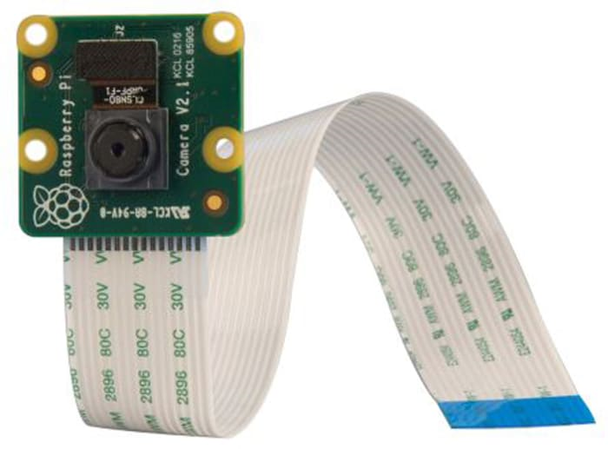
Features of Home automation system:
Temperature monitoring.
Humidity.
Gas leakage detection.
Water level indication.
Security Camera.
Smart home dustbin.

Slide 6
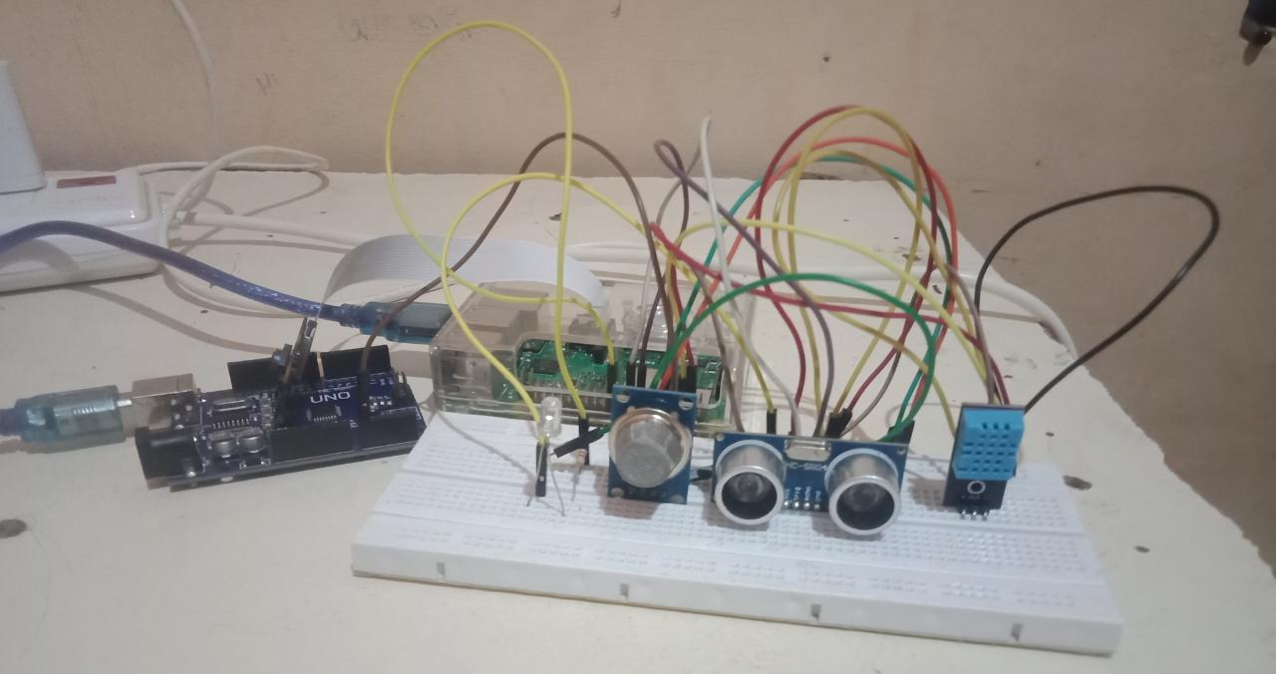

Slide 7
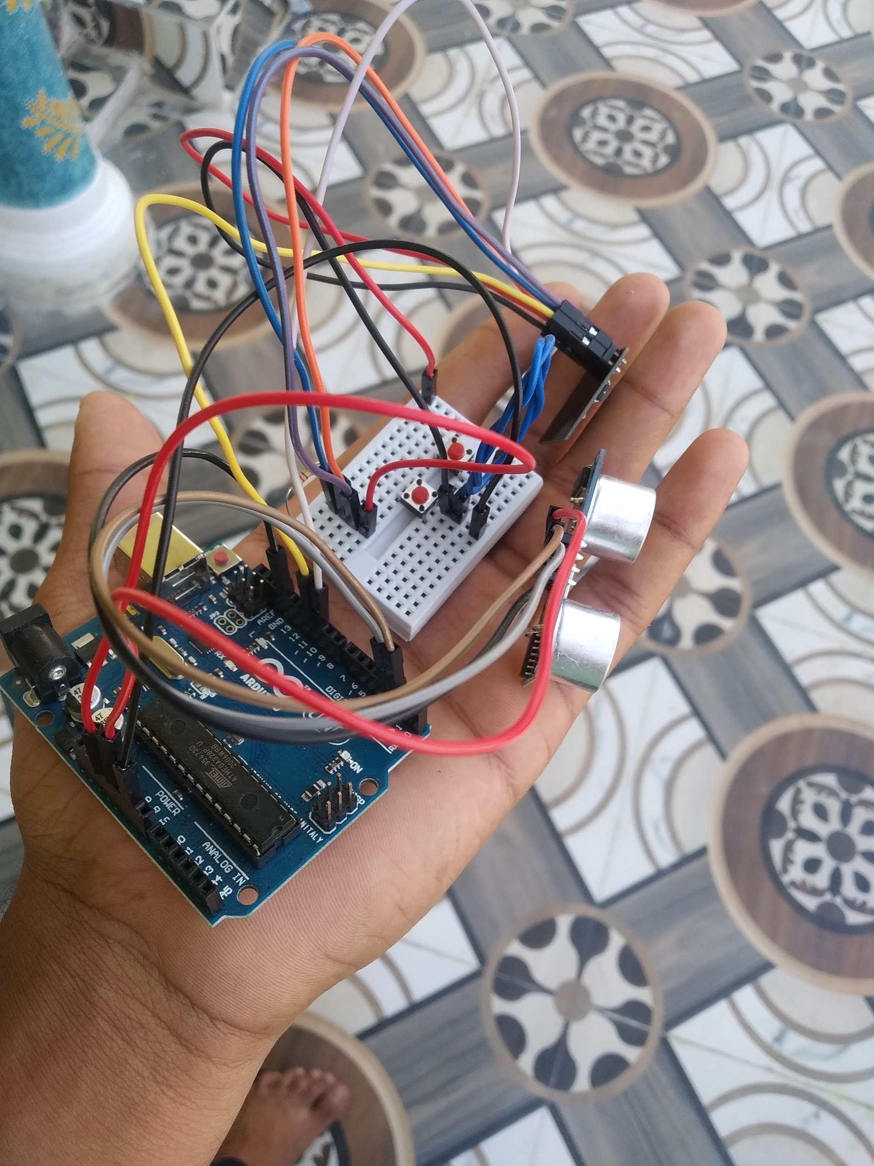
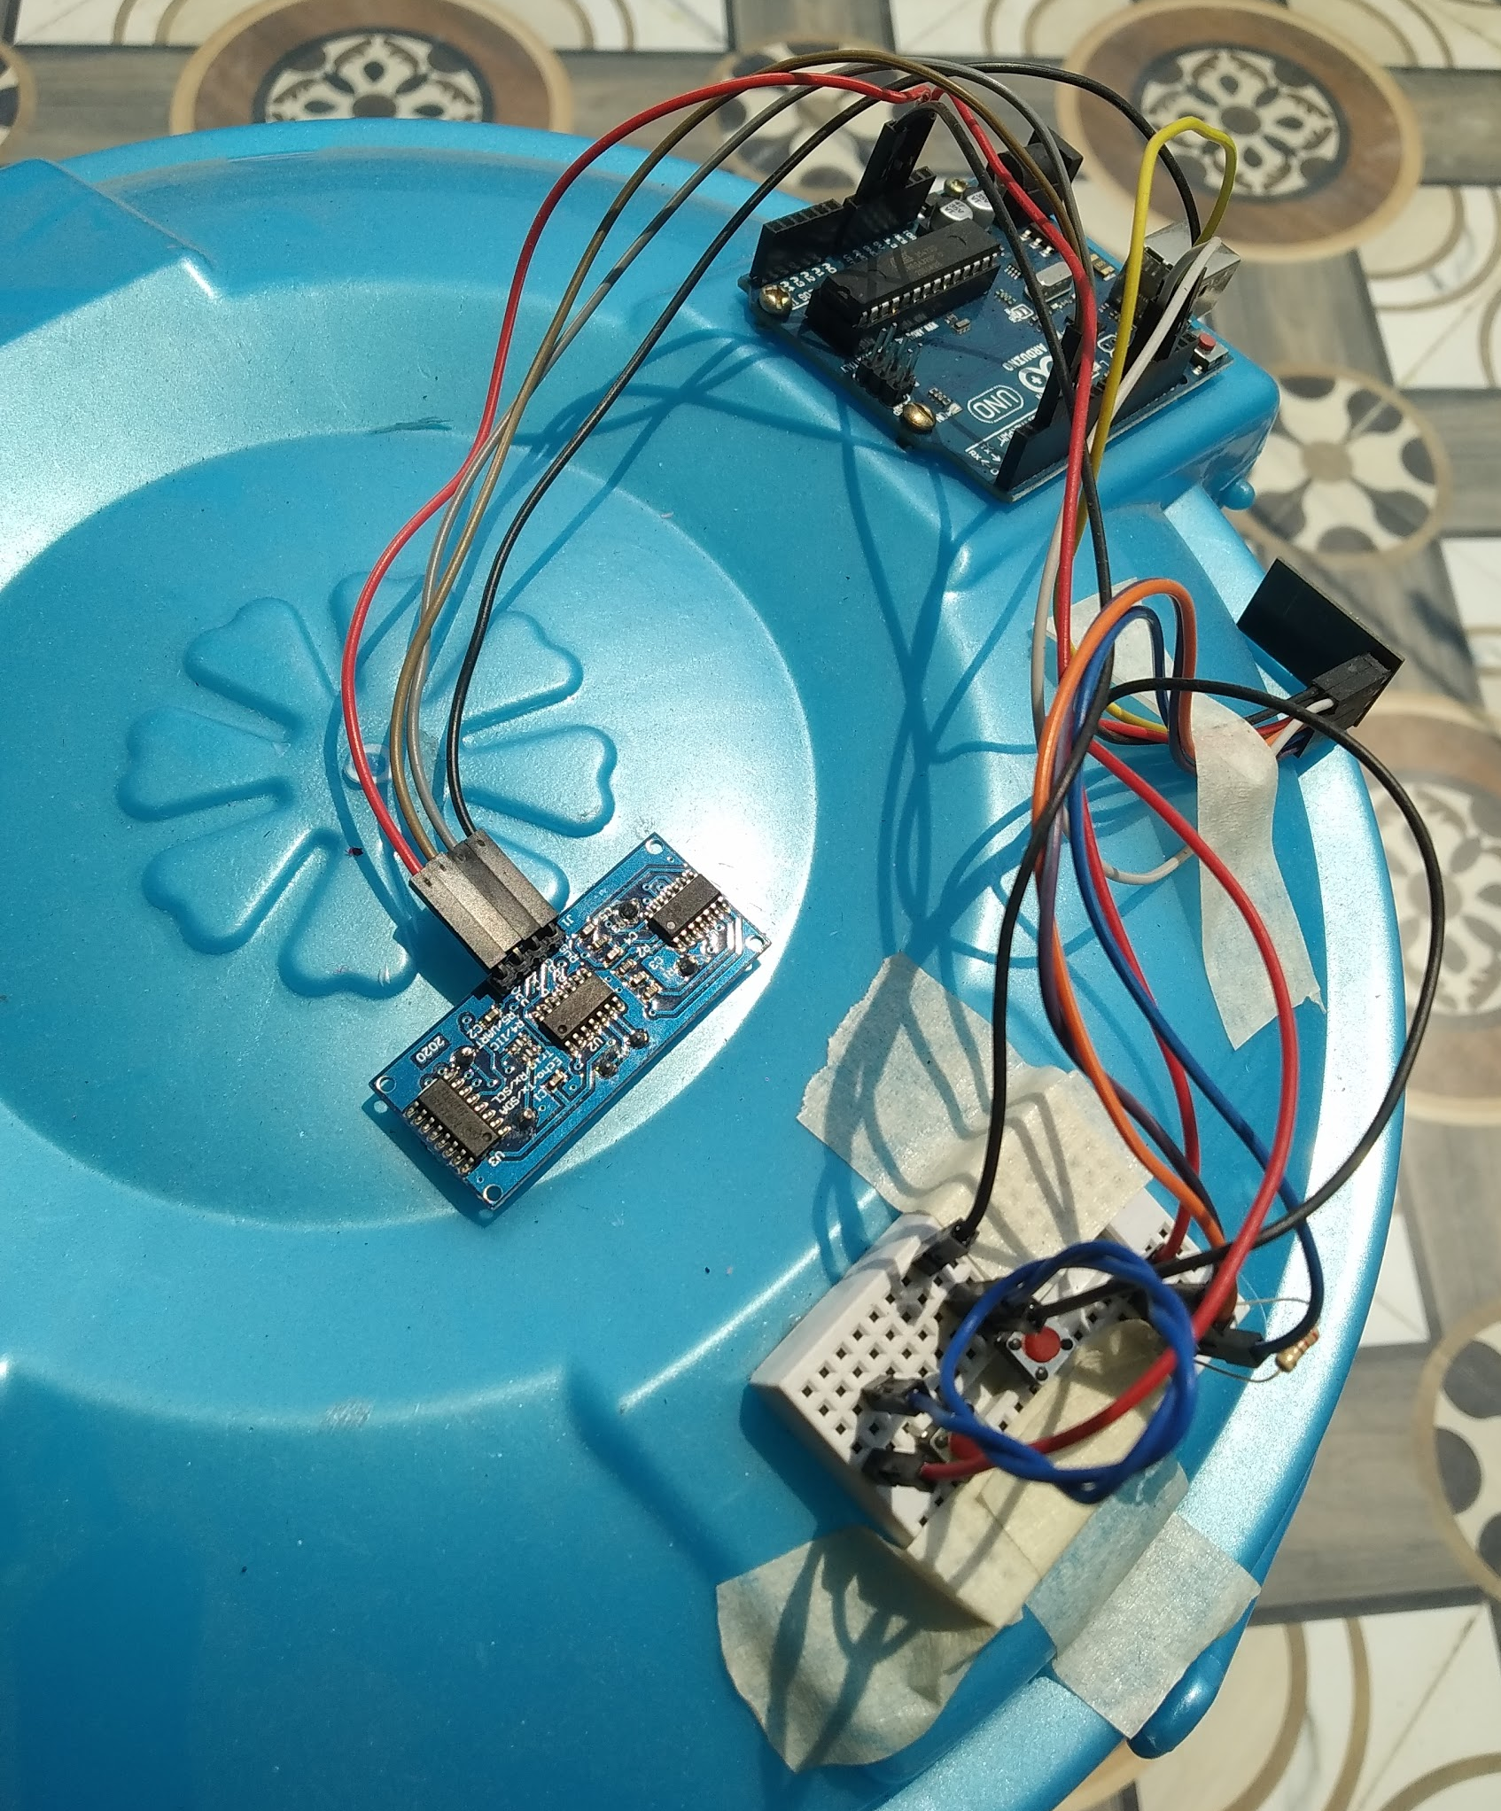
For demo purpose we fixed the module onto the small dustbin and checked its performance.

Slide 8
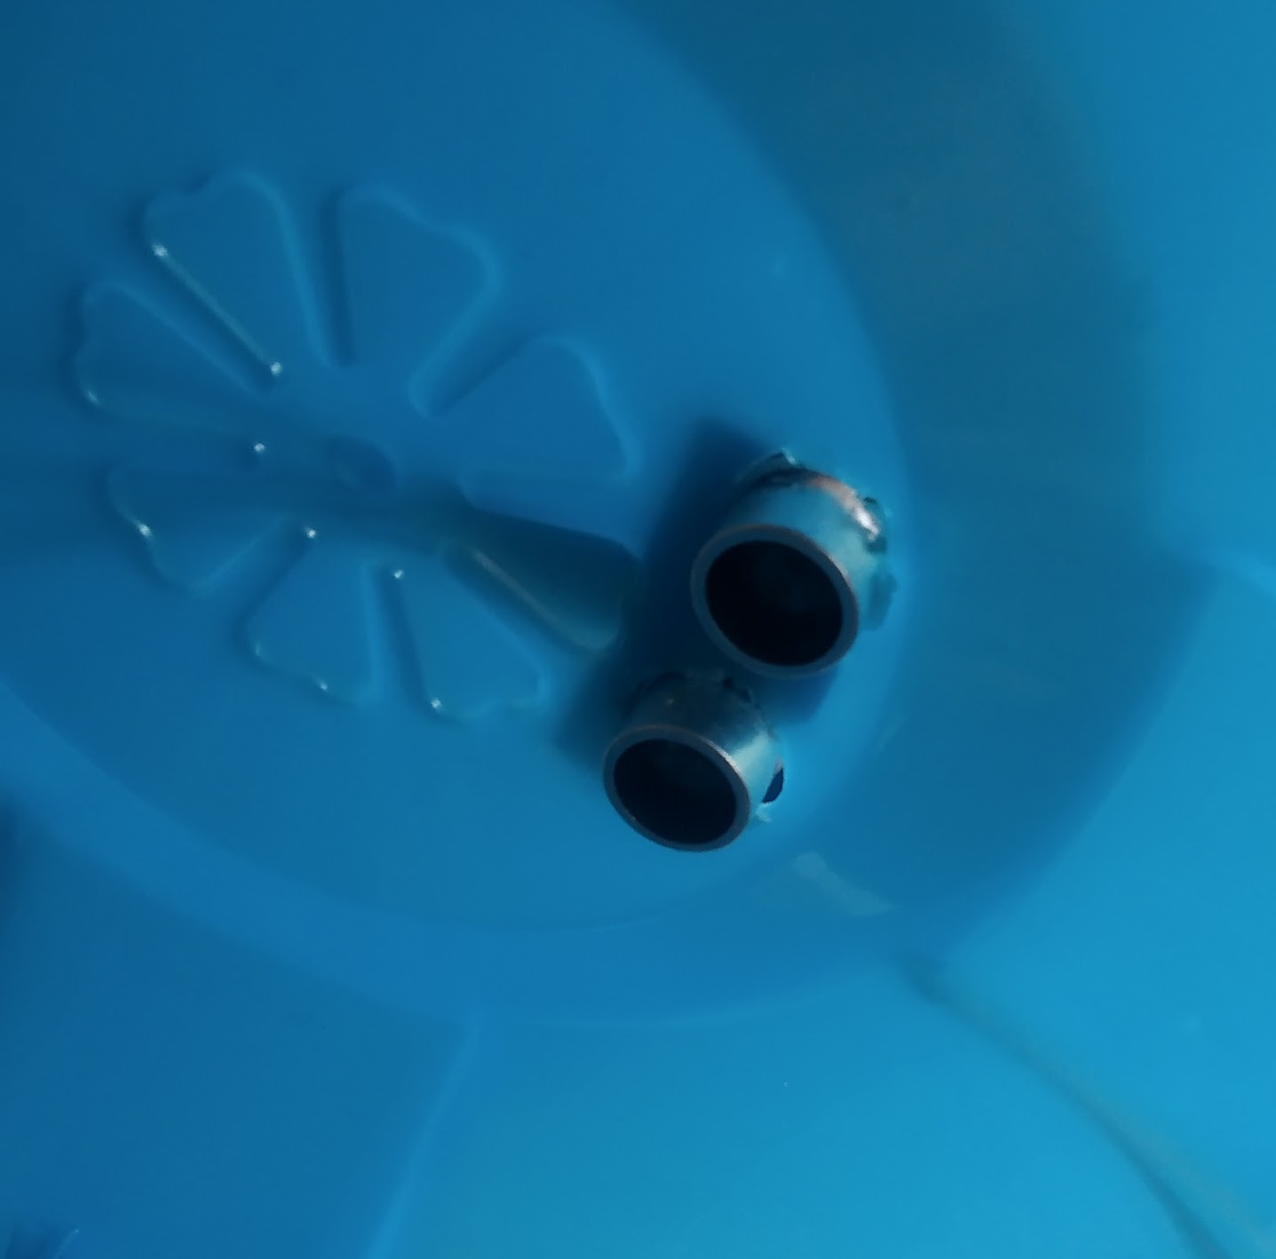
Interior view of the dust bin
Video link of channel creation in thingspeak:
https://youtu.be/ehq28VdjM8Y
Video link of uploading code to arduino uno:
https://youtu.be/OqIzo4FaqsA
Demonstration video link:
https://drive.google.com/file/d/1ZDDyE3r1UvYeT_7pusQywcre3h5chCBE/view?usp=sharing

Slide 9
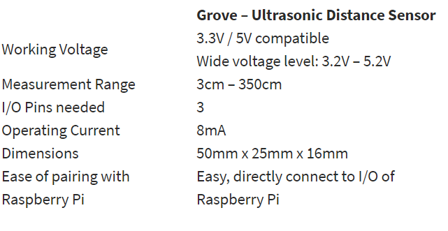
Reason for selecting Ultrasonic Sensor for water level indication:
The ultrasonic sensor emits high-frequency sound waves towards the target object. Target object picks up the sound waves Sound waves are then bounced off and reflected back towards the ultrasonic sensor. The time it took for the sound wave to return is used as the measurement of the distance between.
Not affected by object colour and
transparency as it detects distance
through sound waves.
Works well in places that are dim.
Tend to consume lower current/power.
Multiple interface options for pairing
with a microcontroller, etc.

Slide 10
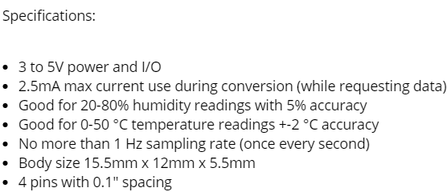
Reason for selecting DHT11 Sensor for temperature and humidity sensing:
The DHT11 is a basic, ultra low-cost digital temperature and humidity sensor. It uses a capacitive humidity sensor and a thermistor to measure the surrounding air, and spits out a digital signal on the data pin (no analog input pins needed). It's fairly simple to use, but requires careful timing to grab data.

Slide 11
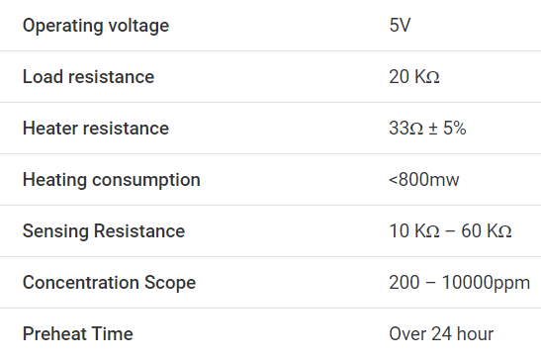
Reason for selecting MQ-2 Sensor for Gas-leakage detection:
It is a Metal Oxide Semiconductor (MOS) type Gas Sensor also known as Chemiresistors as the detection is based upon change of resistance of the sensing material.
MQ2 Gas sensor works on 5V DC and draws around 800mW. It can detect LPG, Smoke, Alcohol, Propane, Hydrogen, Methane and Carbon Monoxide concentrations anywhere from 200 to 10000ppm.

Slide 12
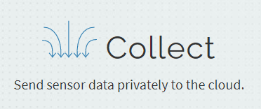
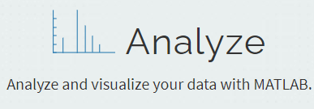
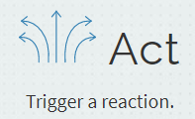
About Thingspeak cloud
ThingSpeak is an IoT analytics platform service that allows you to aggregate, visualize, and analyze live data streams in the cloud. You can send data to ThingSpeak from your devices, create instant visualization of live data, and send alerts.

Slide 13
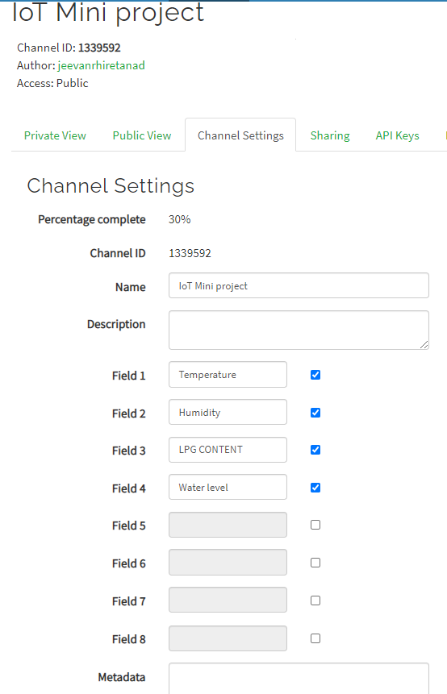
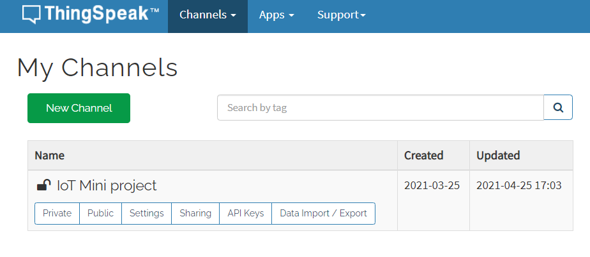
Creating Thingspeak channel

Slide 14
After successfully creating the channel it looks like this

Slide 15
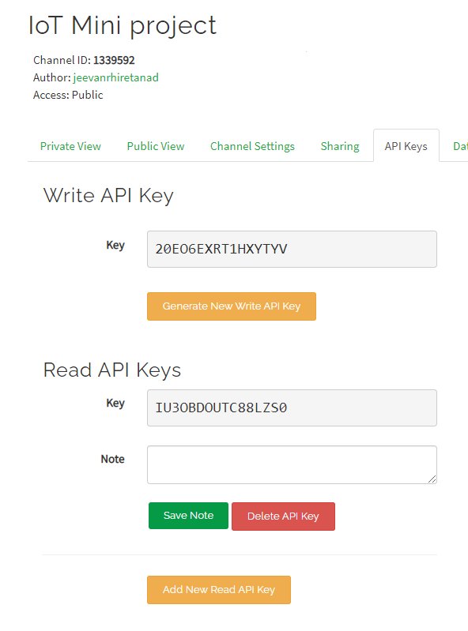
After creating we need to copy channel id, and write api key as we need it for programming.

Slide 16
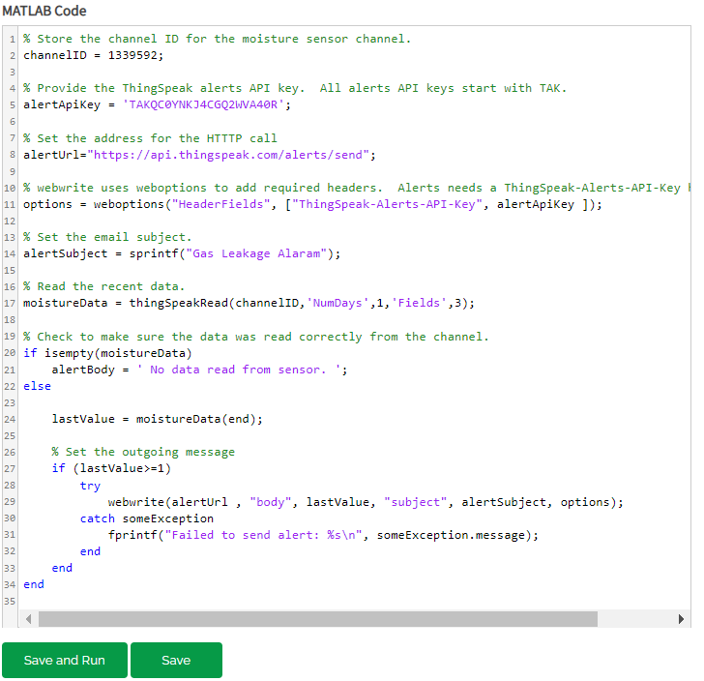
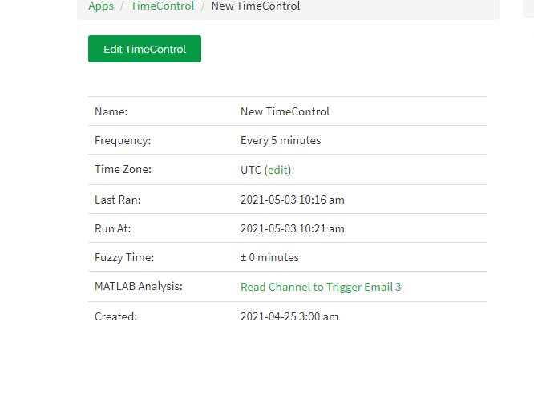
Code to send mail Notification

Slide 17
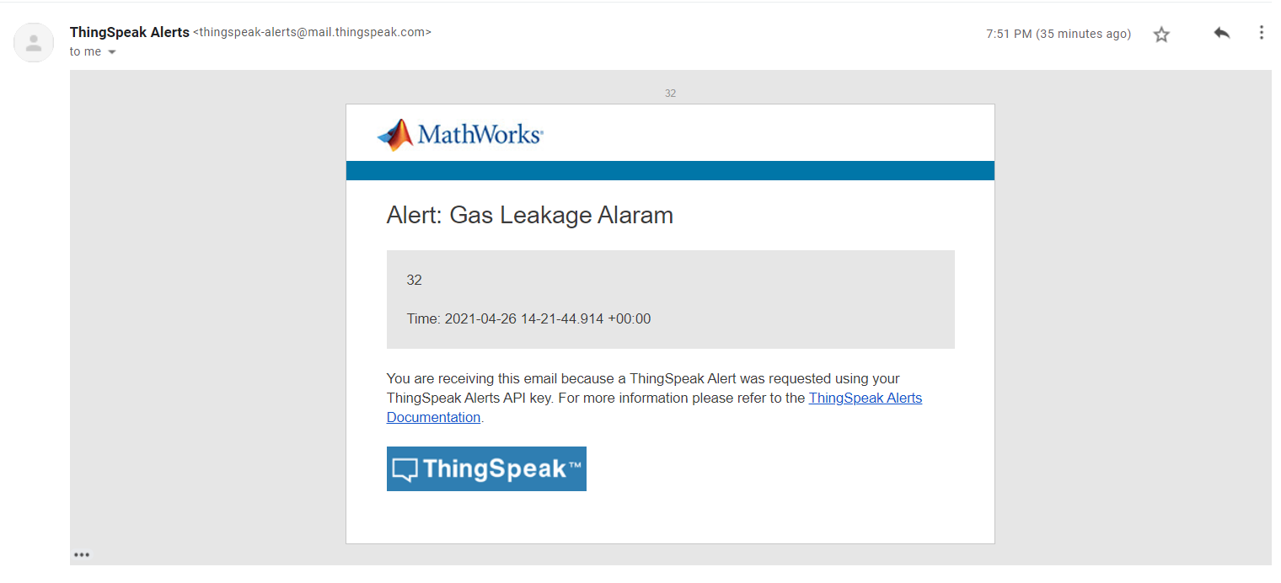

Slide 18
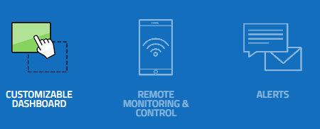


About Cayenne cloud:
Cayenne is the world's first drag-and-drop IoT project builder.We can take full control of our project by creating a custom dashboard with drag-and-drop widgets to visualize, manage, and control connected devices.
Features:

Slide 19
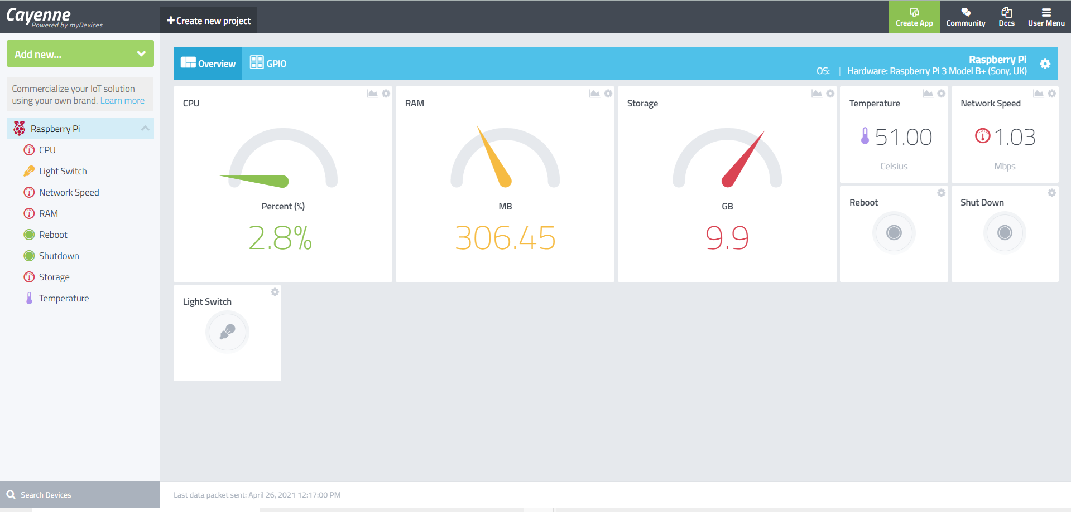
Cayenne Dashboard:

Slide 20
Steps to install Cayenne:
Run the following commands on raspberry pi terminal to install cayenne:-
wget https://cayenne.mydevices.com/dl/rpi_b8w8pn82i9.sh
sudo bash rpi_b8w8pn82i9.sh -v

Slide 21
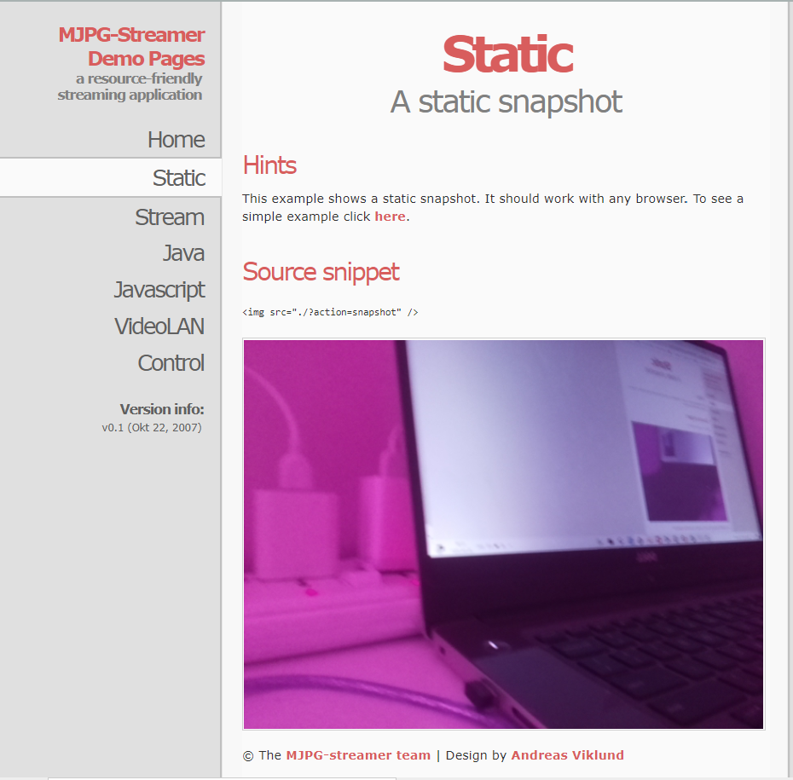
MJPG-Streamer Application:

Slide 22

Future Prediction

Slide 23
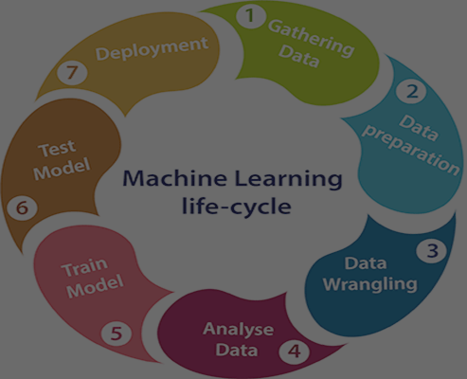
Steps for building machine learning model
Data Collection.
Data Pre-processing.
Choose a model.
Train the model.
Evaluate the model.
Make predictions.

Slide 24
Decision-Tree-Classifier
We are using Decision-Tree-Classifier for training the model. Decision Trees (DTs) are a non-parametric supervised learning method used for classification and regression.
The goal is to create a model that predicts the value of a target variable by learning simple decision rules inferred from the data features.
A tree can be seen as a piecewise constant approximation. DecisionTreeClassifier takes as input two arrays: an array X, sparse or dense, of shape (n_samples, n_features) holding the training samples, and an array Y of integer values, shape (n_samples,), holding the class labels for the training samples

Slide 25
